Slide 1

Yelp Dataset Sentiment Analysis
Phase 2: Project Plan
Cole Hanrahan and Julia Sober
COSC 5540 — Text Mining & Analysis
Fall 2025

Slide 2
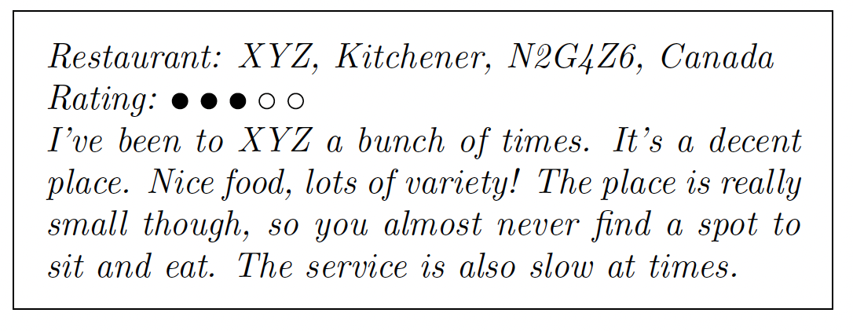
Literature Review Recap — Motivation
Yelp hosts millions of restaurant reviews.
Star ratings summarize satisfaction but are subjective and inconsistent.
Automatically predicting ratings from text helps:
Users gauge sentiment quickly
Businesses identify improvement areas
Researchers study drivers of satisfaction
Source: Asghar et al.

Slide 3
Literature Review Recap — Findings
What prior work found:
Binary sentiment classification (positive vs. negative) → High accuracy (≈ 90%)
Multi-class star prediction (1–5) → Lower accuracy (≈ 60–65%)
Best features: TF-IDF + n-grams
Best models: Logistic Regression, SVM
Deep models (CNNs, Bi-LSTMs, BERT) show promise but struggle with:
Middle ratings (2–3 stars)
Imbalanced data (too many 4–5s)
Sarcasm and slang

Slide 4
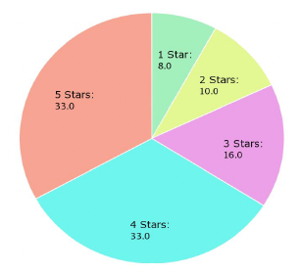
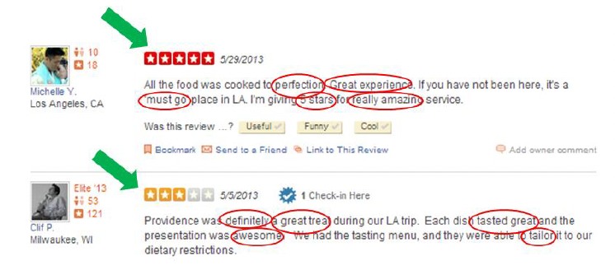
Literature Review Recap — Key Gaps
Context understanding still limited (“Great job burning my pizza!”).
4–5 star dominance causes skewed learning.
Aspect-level and ordinal sentiment analysis underexplored.
Deep models improve nuance but need more explainability.
Source: Asghar et al.
Source: Fan & Khademi

Slide 5
Project Goal
Primary Goal: Predict restaurant review star ratings (1–5) from text.
Secondary Goals:
Compare text feature extraction methods: n-grams, TF-IDF, embeddings.
Evaluate model families: linear, tree-based, neural, ensemble.
Handle class imbalance and analyze per-class performance.
Explore regression and ordinal approaches to better model star order.

Slide 6
Algorithms & Methods
Baseline Models:
Logistic Regression, Naive Bayes, SVM, Passive-Aggressive
Advanced Models:
Random Forest, Gradient Boosting, AdaBoost
Neural networks (MLP + BERT embeddings)
Ensemble / stacking combinations
Experimental Variations:
Regression vs. Classification
Ordinal Logistic Regression
Multi-stage models (e.g., sentiment first → star regression)

Slide 7

Data Preparation
Dataset: Yelp Open Dataset (subset: specific state restaurant reviews).
Tasks:
Filter restaurant reviews.
Clean and normalize text (lowercasing, punctuation removal, stopword removal).
Derive auxiliary features (e.g., review length, punctuation counts).
Split data into training, validation, and test sets. (90% training, 10% test)
Output: Cleaned, balanced dataset ready for modeling.
Source: Columbia University

Slide 8
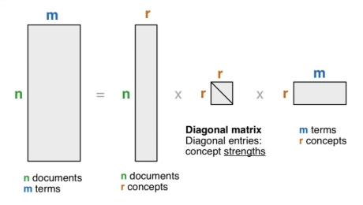
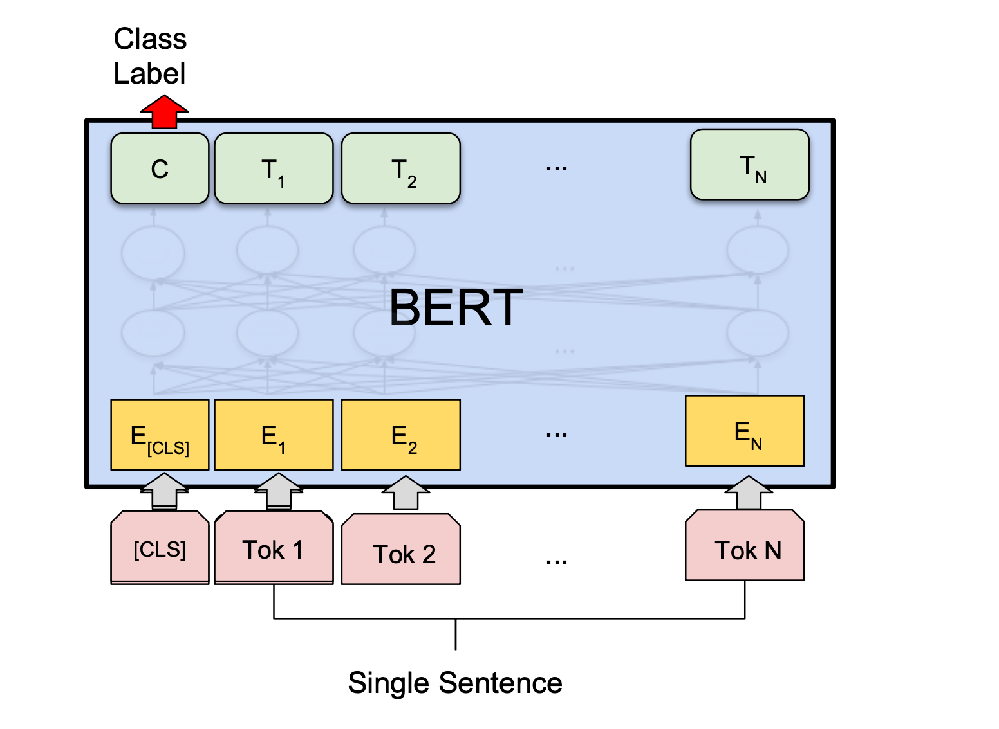
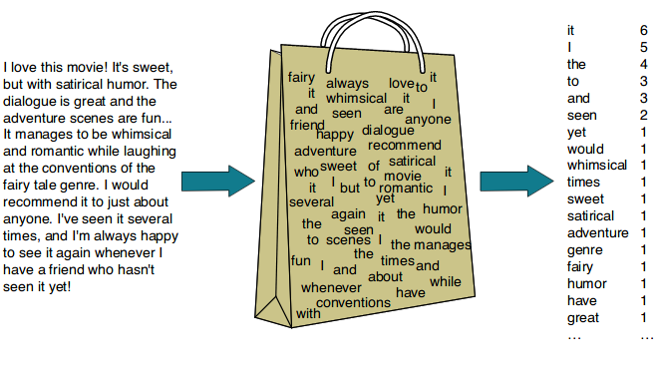
Feature Engineering
Compare multiple text representations:
Bag-of-Words (BoW)
TF-IDF (uni-, bi-, tri-grams)
Hashing Vectorizer (scalable)
Latent Semantic Indexing (SVD/LSI)
Contextual embeddings (BERT)
Optional: sentiment polarity, review length, user votes
Source: Asghar et al.
Source: Wandb
Source: Medium

Slide 9
Experimental Plan
We will run experiments across:
Different feature extraction methods
Different model families
Both classification and regression/ordinal settings
Evaluate effect of balancing techniques (class weights, resampling)
Baseline: TF-IDF + Logistic Regression
Advanced: BERT embeddings + Neural or Ensemble models

Slide 10
Evaluation Metrics
Validation: k-fold cross-validation on training data.
Metrics: Accuracy, RMSE, and macro-F1; per-class recall for minority ratings.
Analysis:
Confusion matrix to diagnose class confusion.
Feature importance or interpretability (keywords, SHAP values).
Test performance on held-out data.

Slide 11
Progress & Next Steps
Completed so far:
Literature review
Dataset exploration
Initial preprocessing + TF-IDF pipeline setup
In progress:
Feature extraction comparisons
Baseline model training (Logistic Regression, SVM)
Next:
Implement ensemble and BERT models
Conduct evaluation and interpret results

Slide 12
Insights & Reporting
Deliverables:
Summary of best-performing model(s).
Key drivers of star ratings (important words, features).
Error analysis—where and why predictions fail.
Expected findings:
Contextual embeddings and ensembles outperform simple TF-IDF models.
2- and 3-star reviews remain hardest to classify due to overlapping language.

Slide 13
Expected Outcomes
Working Yelp text-to-rating model (~60–70% accuracy)
Comparison of traditional vs. contextual representations
Insights into key language features driving satisfaction
Identification of weak performance zones (mid-ratings, sarcasm)

Slide 14
Sources
Sentiment Analysis on Product Reviews Using Machine Learning Techniques; Rajkumar S. Jagdale, Vishal S. Shirsat and Sachin N. Deshmuk
Yelp Dataset Challenge: Review Rating Prediction; Nabiha Asghar
Sentiment Analysis: A Systematic Case Study with Yelp Scores; Wenping Wang Et al.
Ensemble Sentiment Analysis Using Bi-LSTM and CNN; Puneet Singh Lamba Et al.
Sentiment Analysis of Restaurant Reviews using Combined CNN-LSTM; Naimul Hossain Et al.
Sentiment Analysis of Yelp Reviews by Machine Learning; Hemalatha S, Ramathmika
Sentiment Analysis on Food Review using Machine Learning Approach; Nourin Islam, Ms. Nasrin Akter, Abdus Sattar
Sentiment Analysis using Machine Learning Techniques on Python; Ratheee Et al.
Sentiment Analysis of Yelp‘s Ratings Based on Text Reviews; Xu Et al.
Predicting a Business’ Star in Yelp from Its Reviews’ Text Alone; Fan, Khademi

